Slide 1
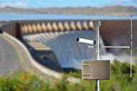
MICROCONTROLLER BASED INDUSTRIAL APPLICATION REPORT PRESENTATION
DAM WATER LEVEL ALERT SYSTEM
Aditya s
21bee1094
Aditya.s2021@vitstudent.ac.in

Slide 2
MICROCONTROLLER BASED INDUSTRIAL APPLICATION REPORT PRESENTATION
PROJECT TITLE: DAM WATER LEVEL ALERT SYSTEM
Problem Statement:
Develop a alerting system for monitoring water level The system should continuously
Real-time Data Monitoring
monitor the water level, inflow, outflow, and other relevant
parameters of the dam in real-time.
Generate alerts and warnings when the dam water level reaches
predefined thresholds or when abnormal patterns are detected.
Flood is a major known natural disaster that causes a huge amount of loss to the environment and living beings. So in these conditions, it is most crucial to get the emergency alerts of water level status at river beds in different conditions. In this project, the objective is to sense the water levels at river beds and check whether they are at a normal condition or not. If they reach beyond the limit, then it alerts the people through LED indications as well as through internet application. Here we are using an ultrasonic sensor to sense the river levels and a NodeMCU ESP8266 to process these data.

Slide 3
Scope of the solution
Briefly introduce the concept of a Dam Water Level Alert System.
Highlight the importance of such a system for dam safety and flood prevention.
Sensors: Water level sensors, weather sensors, and other relevant sensors.
Data Acquisition System: Collects and processes data from sensors
•Accuracy of Sensors: The accuracy of the sensors used to measure water levels is crucial. Sensor inaccuracies can lead to false alarms or missed warnings. Regular calibration and maintenance of sensors are essential.
Limited Warning Time: In some situations, such as rapid dam breaches or flash floods, there may be limited warning time. The system should be capable of providing as much advance notice as possible.9

Slide 4

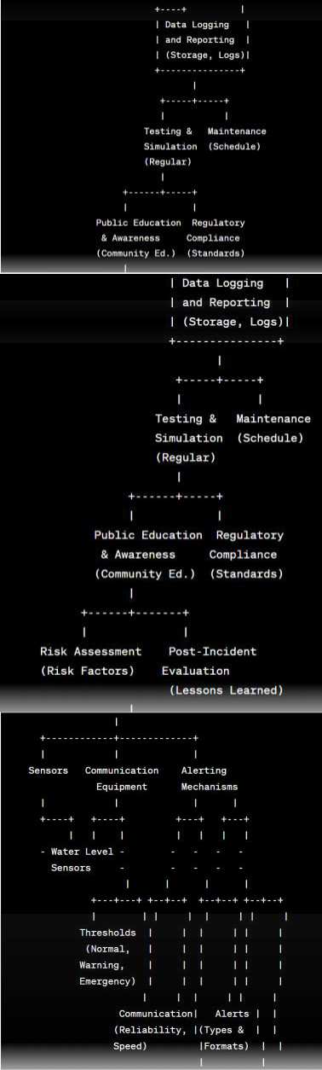
Stage c Tool outcome metrics/Rubrics
 | Stage- II – Idea Posting | Mind-map | Document https://drive.google.com/file/d/ 1paeVilWX0MX6G2hFLuHbuXN2hXcXWP8J /view Copy link to view ABSTRACT |  |  | Post-Incident
 |  |  |  |  |  | Evaluation:
 |  |  |  |  |  |  |  | After any incident or alert, conduct a thorough evaluation to assess the system's performance and identify areas for improvement.
 |  |  |  |  | 2. |  | Public Feedback:
 |  |  |  |  |  |  |  | Collect feedback from the public and stakeholders on the effectiveness of the alert system and use this feedback to make necessary improvements.
 |  |  |  |  | 3. |  | Redundancy and
 |  |  |  |  |  |  | Backup Systems:
 |  |  |  |  |  |  |  | Ensure that the alert system has redundancy and backup systems to minimize the risk of failure during critical events

Slide 5
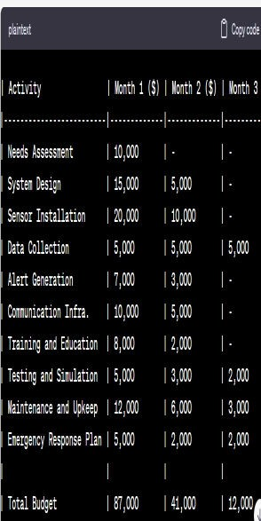
Stage
Tool
Outcome
Metrics /Rubrics
Project Execution Schedule
Risk
Stage VIII –
planning
Constraints
Assumptions

Slide 6

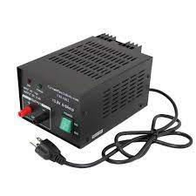
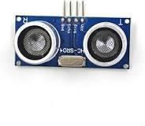
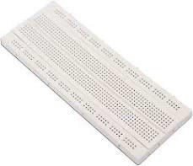
REQUIRED HARDWARE COMPONENTS TO DEVELOP THE SOLUTION
Hardware part
ESP8266 NodeMCU
Power supply------------------→
Ultersonic Sensor
Bread board

Slide 7
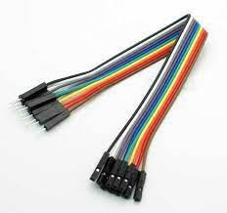

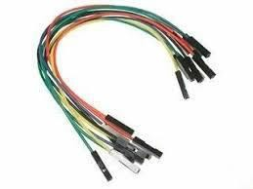
-→ jumpers
Led
Wiring and connection

Slide 8
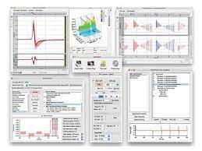
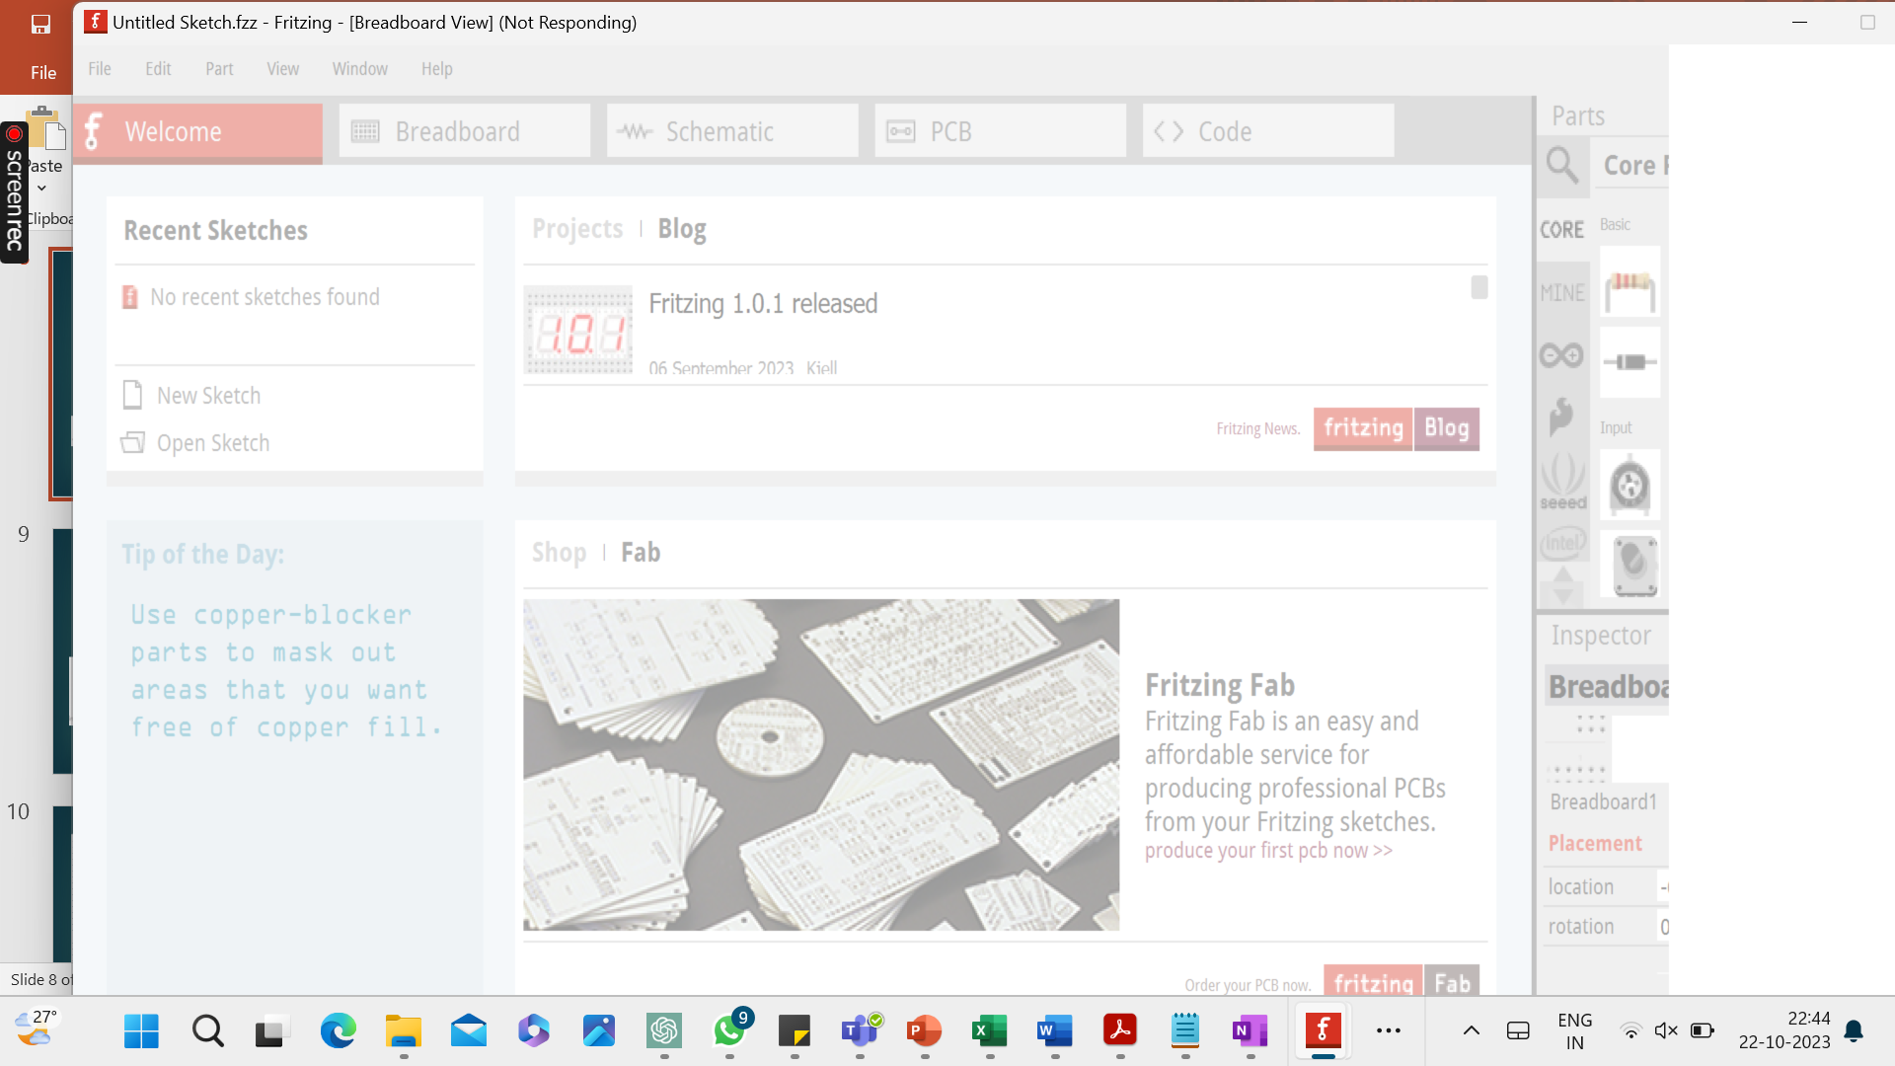
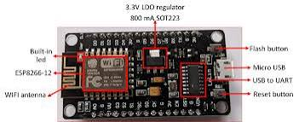
SOFTWARE:
fritzing
Esp 8266 node mcu

Slide 9
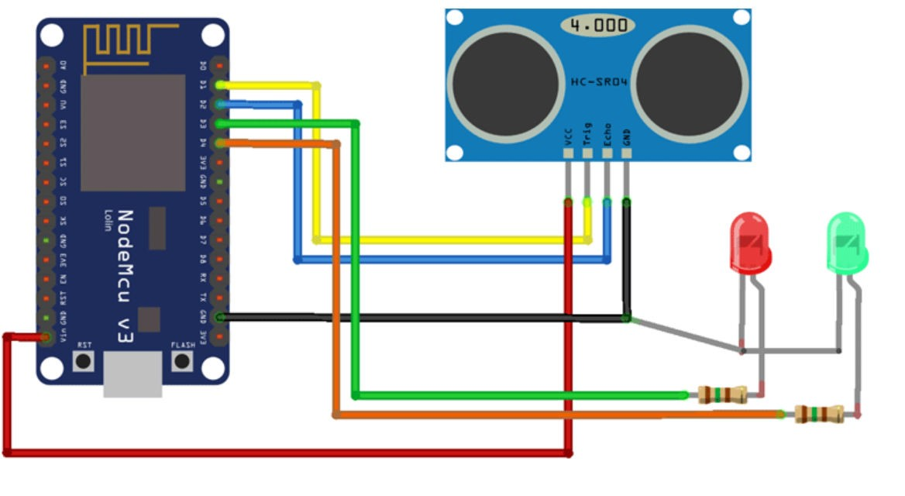
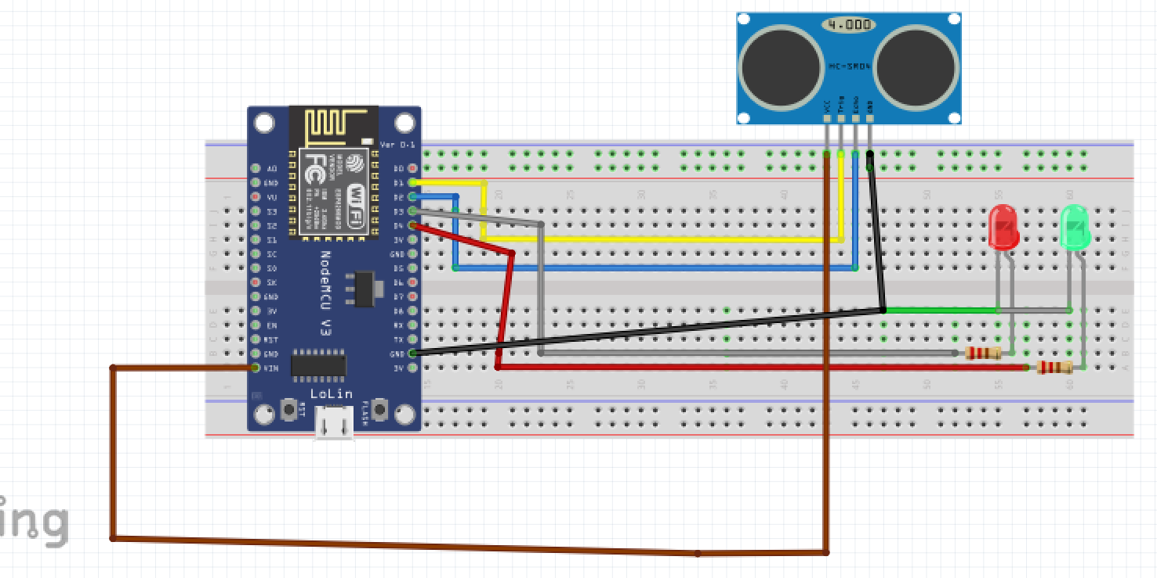
Stimulated Circuit (fritzing)
Fritzing stimulated diagram:

Slide 10
7 CODE FOR THE SOLUTION for thinkspeak:-
#include "ThingSpeak.h"
#include <ESP8266WiFi.h> const int trigPin1 = D1; const int echoPin1 = D2;
#define redled D3
#define grnled D4
unsigned long ch_no = 102xxxx; const char * write_api = "SXSSSSS";
char auth[] = "fuEERRXXXXXXXXXXXXXX";
char ssid[] = "admin"; char pass[] = ""; unsigned long startMillis;
unsigned long currentMillis;
const unsigned long period = 10000; WiFi.begin(ssid, password);
while (WiFi.status() != WL_CONNECTED)
{
delay(500); Serial.print(".");
}
Serial.println("WiFi connected"); Serial.println(WiFi.localIP());
ThingSpeak.begin(client); digitalWrite(trigPin1, LOW);
delayMicroseconds(2);
digitalWrite(trigPin1, HIGH); delayMicroseconds(10); digitalWrite(trigPin1, LOW); duration1 = pulseIn(echoPin1, HIGH); distance1 = duration1 * 0.034 / 2;
if (distance1 <= 4)
{
digitalWrite(D3, HIGH);

Slide 11
digitalWrite(D4, LOW);
}
else
{
digitalWrite(D4, HIGH); digitalWrite(D3, LOW);
}
if (currentMillis - startMillis >= period)
{
ThingSpeak.setField(1, distance1); ThingSpeak.writeFields(ch_no, write_api); startMillis = currentMillis;
}
Code
#include "ThingSpeak.h"
#include <ESP8266WiFi.h> const int trigPin1 = D1; const int echoPin1 = D2;
#define redled D3
#define grnled D4
unsigned long ch_no = 1026389;//Replace with Thingspeak Channel number const char * write_api = "XK88XXXXXXX";//Replace with Thingspeak write API char auth[] = "fu0o5JaLXXXXXXXXXXXXXXXX";
char ssid[] = "admin"; char pass[] = ""; unsigned long startMillis;
unsigned long currentMillis;
const unsigned long period = 10000; WiFiClient client;
long duration1; int distance1; void setup()
{
pinMode(trigPin1, OUTPUT); pinMode(echoPin1, INPUT); pinMode(redled, OUTPUT); pinMode(grnled, OUTPUT); digitalWrite(redled, LOW); digitalWrite(grnled, LOW); Serial.begin(9600); WiFi.begin(ssid, pass);
while (WiFi.status() != WL_CONNECTED)
{
delay(500); Serial.print(".");
}

Slide 12
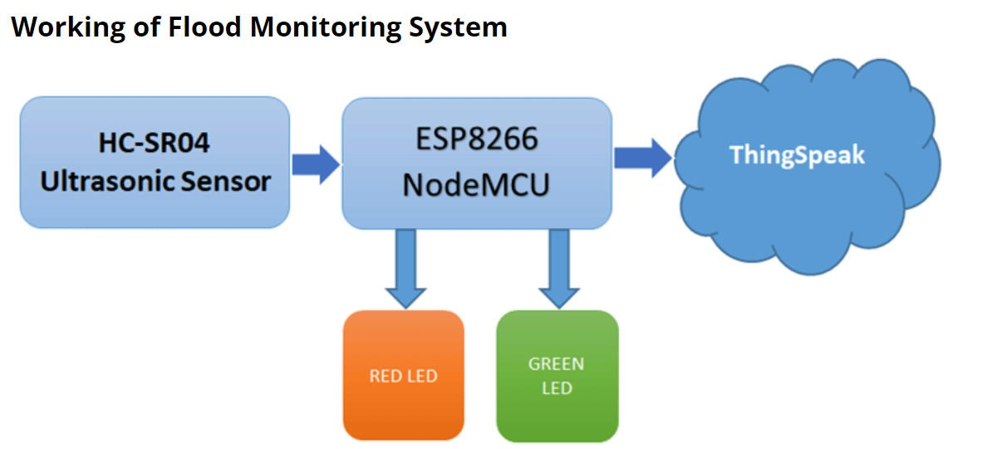
Serial.println("WiFi connected"); Serial.println(WiFi.localIP()); ThingSpeak.begin(client);
startMillis = millis(); //initial start time
}
void loop()
{
digitalWrite(trigPin1, LOW); delayMicroseconds(2); digitalWrite(trigPin1, HIGH); delayMicroseconds(10); digitalWrite(trigPin1, LOW); duration1 = pulseIn(echoPin1, HIGH); distance1 = duration1 * 0.034 / 2; Serial.println(distance1);
if (distance1 <= 4)
{
digitalWrite(D3, HIGH); digitalWrite(D4, LOW);
}
else
{
digitalWrite(D4, HIGH); digitalWrite(D3, LOW);
}
currentMillis = millis();
if (currentMillis - startMillis >= period)
{
ThingSpeak.setField(1, distance1); ThingSpeak.writeFields(ch_no, write_api); startMillis = currentMillis;
}
}
Flow chat of basic working of flood monitoring system

Slide 13
Code for fritzing ESP8266
include <SoftwareSerial.h>
#include <Wire.h>
#include <dht.h>
#include <Adafruit_BMP085.h>
#define DEBUG 0 // change value to 1 to enable debuging using serial monitor
#define dht_pin A0 // defining pin A0 for DHT sensor
#define lightSensor A1 // defining pin A1 as input pin for LDR voltage divider
dht DHT;
Adafruit_BMP085 bmp;
SoftwareSerial esp8266Module(10, 11); // RX, TX
String network = "----"; // your access point SSID
String password = "-------------"; // your wifi Access Point password
#define IP "184.106.153.149" // IP address of thingspeak.com
String GET = "GET /update?key=----------------"; // replace with your channel key
void setup()
{
if(DEBUG){
Serial.begin(9600); // Setting hardware serial baud rate to 9600
}
esp8266Module.begin(9600); // Setting softserial baud rate to 9600
if (!bmp.begin()) {
if(DEBUG){
Serial.println("Could not find a valid BMP085 sensor, check wiring!");
}
while (1) {}
}
delay(2000);
}
void loop()
{
setupEsp8266();
DHT.read11(dht_pin);
double humi = DHT.humidity;
double bmp_temp = bmp.readTemperature();
double bmp_pressure = bmp.readPressure();
int lightIntensity = analogRead(lightSensor);
updateTemp(String(bmp_temp) ,String(lightIntensity),String(bmp_pressure),String(humi));
delay(30000);
}
//-------------------------------------------------------------------
// Following function setup the esp8266, put it in station made and
// connect to wifi access point.
//------------------------------------------------------------------
void setupEsp8266()
{
if(DEBUG){
Serial.println("Reseting esp8266");
}
esp8266Module.flush();
esp8266Module.println(F("AT+RST"));
delay(7000);
if (esp8266Module.find("OK"))
{
if(DEBUG){
Serial.println("Found OK");
Serial.println("Changing espmode");
}
esp8266Module.flush();
changingMode();
delay(5000);
esp8266Module.flush();
connectToWiFi();
}
else
{

Slide 14
if(DEBUG){
Serial.println("OK not found");
}
}
}
//-------------------------------------------------------------------
// Following function sets esp8266 to station mode
//-------------------------------------------------------------------
bool changingMode()
{
esp8266Module.println(F("AT+CWMODE=1"));
if (esp8266Module.find("OK"))
{
if(DEBUG){
Serial.println("Mode changed");
}
return true;
}
else if(esp8266Module.find("NO CHANGE")){
if(DEBUG){
Serial.println("Already in mode 1");
}
return true;
}
else
{
if(DEBUG){
Serial.println("Error while changing mode");
}
return false;
}
}
//-------------------------------------------------------------------
// Following function connects esp8266 to wifi access point
//-------------------------------------------------------------------
bool connectToWiFi()
{
if(DEBUG){
Serial.println("inside connectToWiFi");
}
String cmd = F("AT+CWJAP=\"");
cmd += network;
cmd += F("\",\"");
cmd += password;
cmd += F("\"");
esp8266Module.println(cmd);
delay(15000);
if (esp8266Module.find("OK"))
{
if(DEBUG){
Serial.println("Connected to Access Point");
}
return true;
}
else
{
if(DEBUG){
Serial.println("Could not connect to Access Point");
}
return false;
}
}

Slide 15
//-------------------------------------------------------------------
// Following function sends sensor data to thingspeak.com
//-------------------------------------------------------------------
void updateTemp(String voltage1,String voltage2,String voltage3,String voltage4)
{
String cmd = "AT+CIPSTART=\"TCP\",\"";
cmd += IP;
cmd += "\",80";
esp8266Module.println(cmd);
delay(5000);
if(esp8266Module.find("Error")){
if(DEBUG){
Serial.println("ERROR while SENDING");
}
return;
}
cmd = GET + "&field1=" + voltage1 + "&field2=" + voltage2 + "&field3=" + voltage3 + "&field4=" + voltage4 + "\r\n";
esp8266Module.print("AT+CIPSEND=");
esp8266Module.println(cmd.length());
delay(15000);
if(esp8266Module.find(">"))
{
esp8266Module.print(cmd);
if(DEBUG){
Serial.println("Data sent");
}
}else
{
esp8266Module.println("AT+CIPCLOSE");
if(DEBUG){
Serial.println("Connection closed");
}
}
}

Slide 16
Result: the dam water level monitoring system is demonstrated
This is just a basic model for IoT based flood monitoring and alerting system, and there is a lot of scope for improvement. I hope you like the project and learned something new out of it.

